Slide 1
PASTURED PIGS at BLUESTEM FARM
Aaron Brower

Slide 2
Bluestem Farm
80 acres of fields, woods, and pasture
14 acres of certified organic vegetables fields in rotation. 10 acres in production. 4 acres in cover crop and chickens every year
1000 layers on pasture in the summer; 700 in the winter
About 1500 meat birds in the summer
60 pigs every year

Slide 3
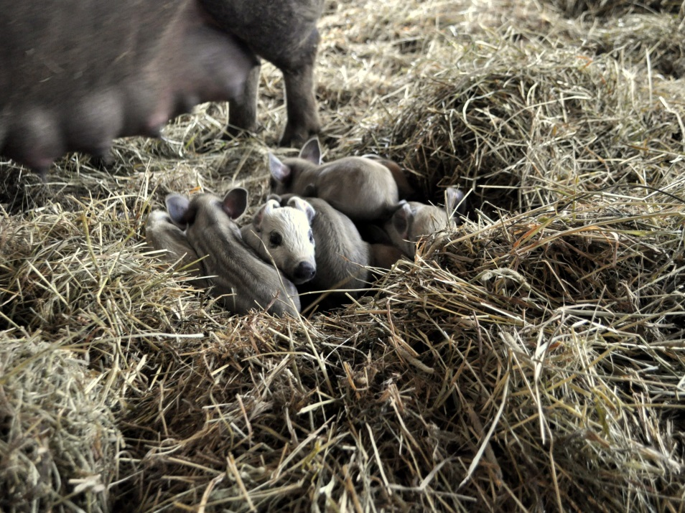
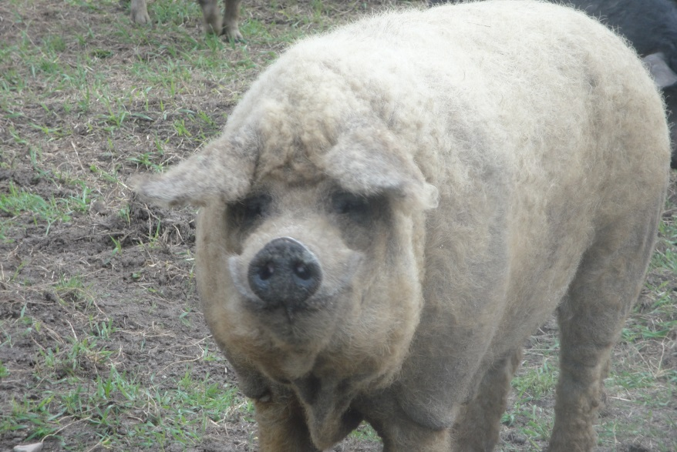
Our Pastured Pig Model
Farrow to finish
2 boars
A closed herd for over 3 years
On pasture and in the woods
portable electric fencing
9-12 month life span
Age improves the quality of the pork
Feed:
wheat, oats, barley, mineral
lots of hay in the winter

Slide 4
Breeds
Primary boar is a pure Mangalitsa
Sows are Large Black/ Mangalitsa and Berkshire/Mangalitsa
Mangalitsa
Wooly, slow growth, excellent quality of meat, lots of lard, good on pasture
Large Black
excellent mothers, calm disposition, fantastic bacon, fatty
Berkshires
a bit leaner, a sweeter disposition, good on pasture, pretty

Slide 5
Marketing
High quality proteins are not cheap.
Not a commodity crop for Bluestem
Our pork is not lean
Monthly distributions through our CSA
Year round
Our animals are visible from the road. We believe it is important that the animals that people consume are part of the landscape. They have a life before their death. People need to see that life.

