Slide 1
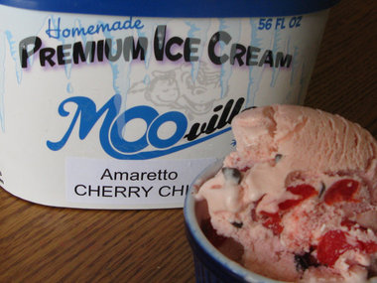
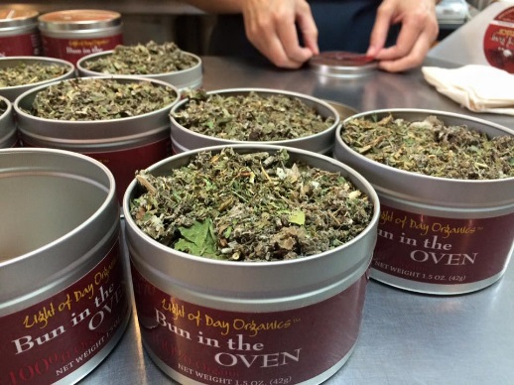
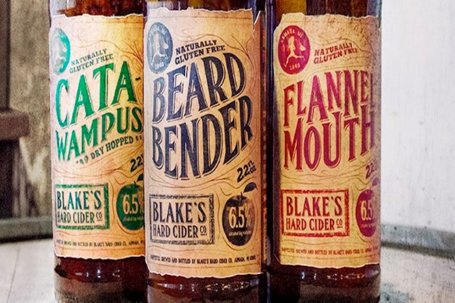
FY2018
Value-Added Producer Grant 101
Northern Michigan Small Farm Conference- Traverse City

Slide 2
Value-Added Producer Grant
Program Regulation
Final Rule 7 CFR part 4284 subpart J
published May 8, 2015
Notes:
Note: 7 CFR 4284-A no longer applies to VAPG

Slide 3

Purpose
Provides funds for economic planning activities or eligible working capital expenses to enable viable Agricultural Producers to develop businesses that produce and market Value-Added Agricultural Products and to create marketing opportunities for such businesses.

Slide 4
  National Competition
  Available Funding: $18 million+
  Application Deadlines:
  Paper: January 31
  Grants.gov: January 24(not recommended)
  Maximum Award Amounts
  $75,000 Planning
  $250,000 Working Capital
  Matching Requirement
1-to-1 match (50 percent of total project costs) cash or eligible in-kind contributions to be used only for eligible project purposes.
Grant Period
Up to 36 months, depending on project complexity.

Slide 5
Scoring Priorities
Priority Points (5 pts)
  Beginning Farmers
  Veteran Farmers
  Socially Disadvantaged Farmers
  Operators of Small-/Medium-Sized Farms Structured as Family Farms
  Farmer or Rancher Cooperatives
  Mid-Tier Value Chain Projects
Priority Points (up to 5 pts) ‘Group’ Applicants:’ Agricultural Producer Groups, Farmer or Rancher Cooperatives, Majority Controlled Producer-Based Businesses that ‘best contribute to creating or expanding marketing opportunities for Beginning, Socially-Disadvantaged, and Small-/Medium Family Farms.

Slide 6
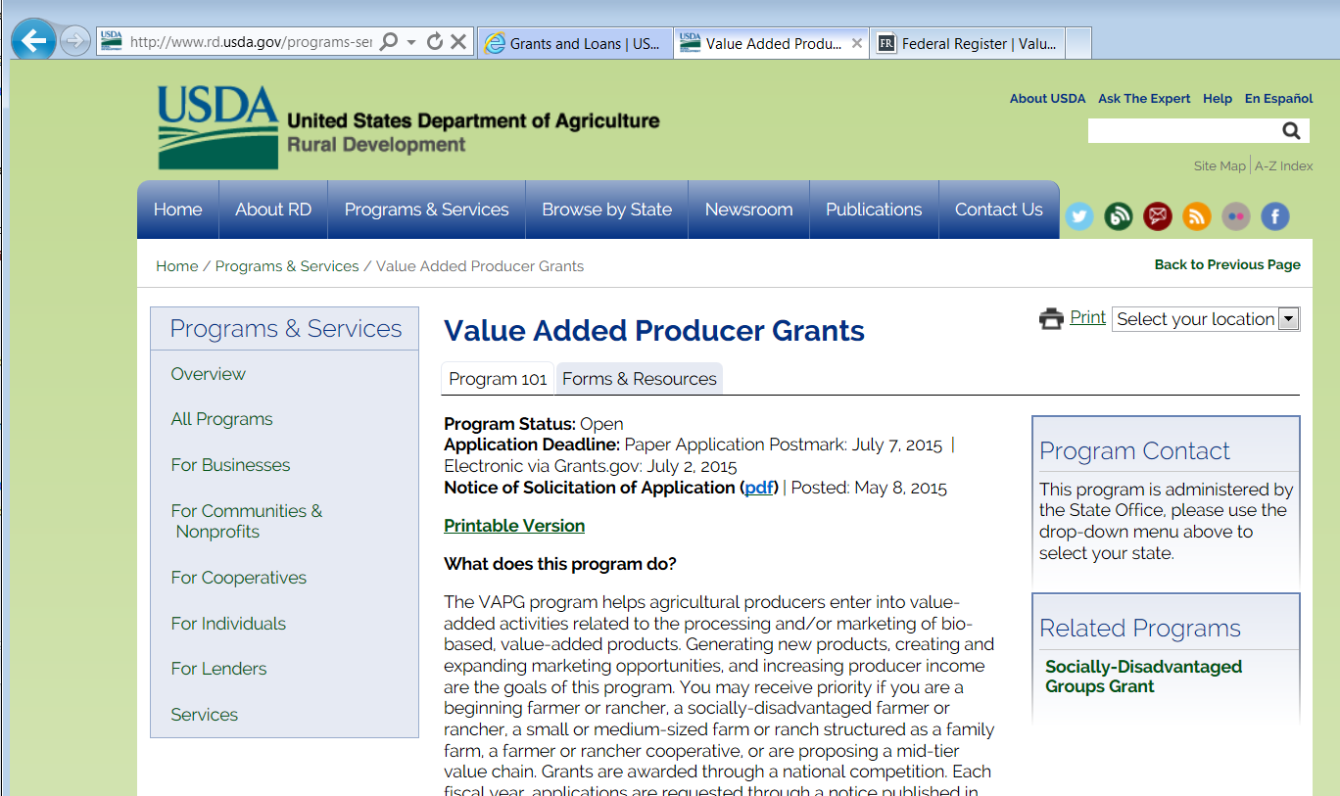
Program Information & Materials
http://www.rd.usda.gov/programs-services/value-added-producer-grants

Slide 7
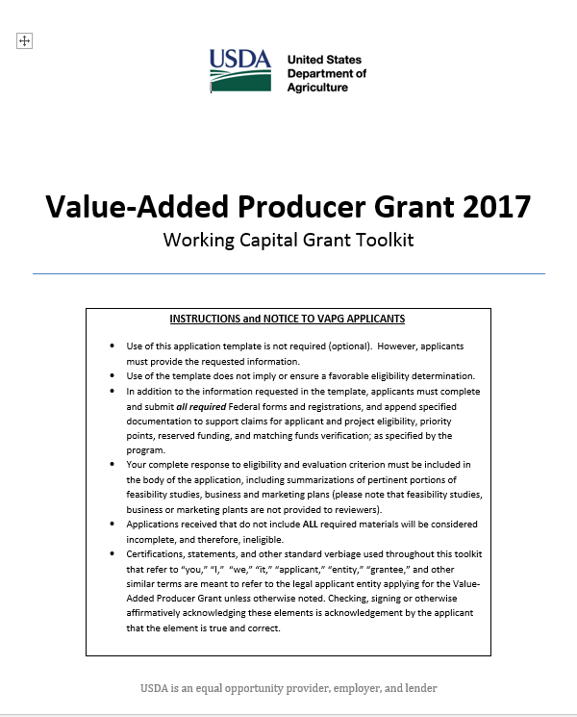
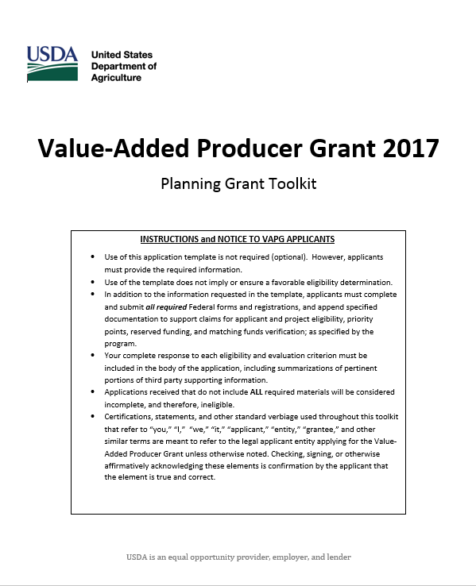
Tools for applicants
Comprehensive Toolkits for Planning and Working Capital
Notes:
Toolkits for applicants (one for Planning and one for Working Capital) contain checklists, links to forms and resources, and ‘optional but highly recommended’ application templates.

Slide 8
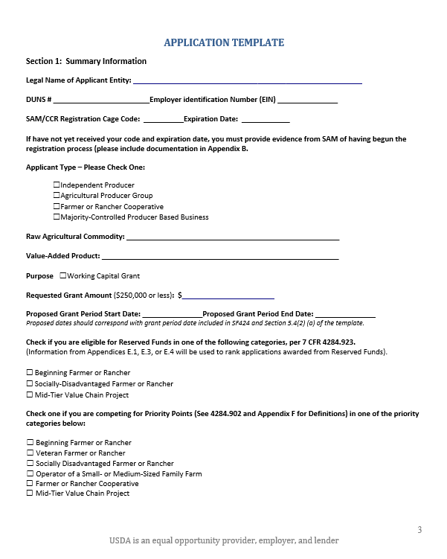
Separate OPTIONAL templates for Planning and Working Capital applications
Use of the Templates are OPTIONAL, but highly recommended
Notes:
Check boxes and narrative insertion points
Hyperlinks to reg throughout

Slide 9
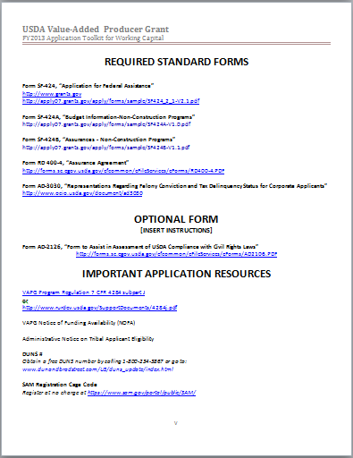
Links to required forms and necessary resources, including:
SF 424s
AD 3030
Program regulation
NOFA
And more!

Slide 10
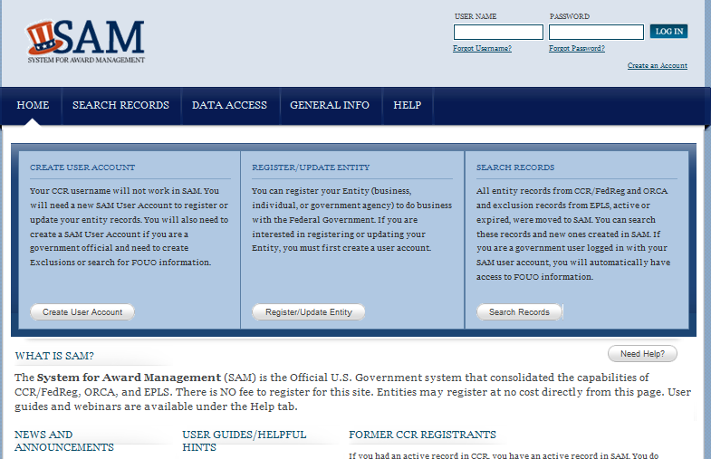
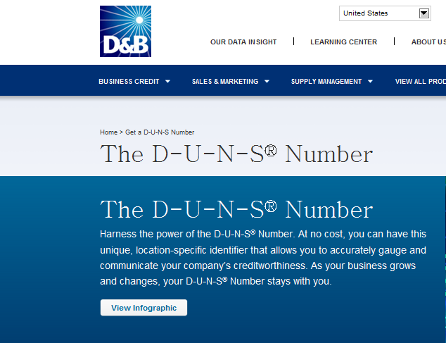
Links to DUNS and SAM
Notes:
To ensure that applicants get to the free DUNS and SAM registration pages, avoiding fee-based middlemen.

Slide 11
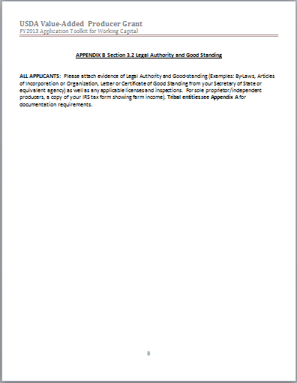
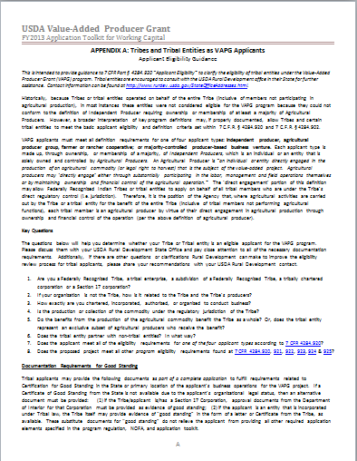
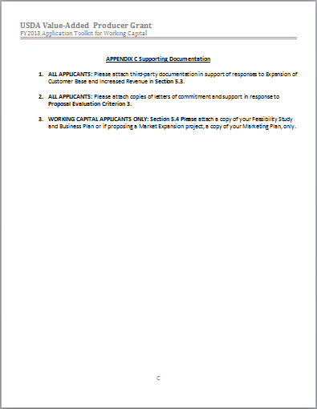
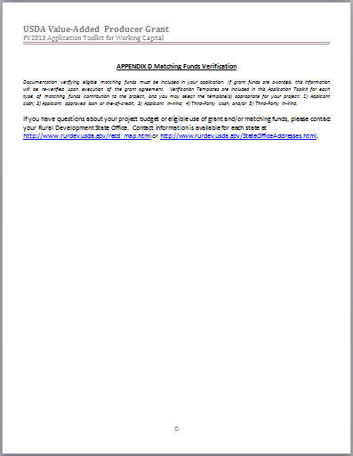

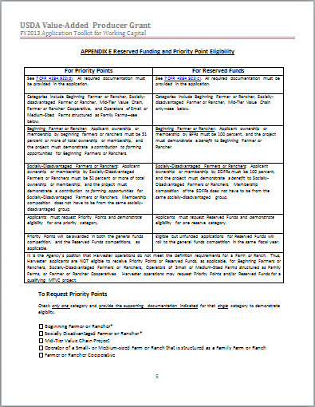
Appendices
Guidance for tribal applicants
Attachment points for required documentation
Matching fund verification templates
Reserve fund eligibility and priority point guidance

Slide 12
“An individual or entity that produces an Agricultural Commodity through participation in the day-to-day labor, management, and field operations…”
…and must meet the definition of one of four applicant types:
Eligible Applicants Must Be Agricultural Producers:
Notes:
See Definitions at 4284.902
Note harvester: must have rights to harvest; timber, commercial fishing.
See also exception for Tribal entities

Slide 13
Independent Producer
An individual agricultural producer or an entity* that is solely owned and controlled by agricultural producers, that are directly engaged in the production of the subject agricultural commodity.
*Entity= partnership, LLC, etc.

Slide 14


Agricultural Producer Group
Formal nonprofit membership organization that represents Agriculture Producers that meet the VAPG program definition requirements for an Independent Producer and operates with a mission that includes working on behalf of Independent Producers.
The majority of the applicant’s membership meet the definition of Independent Producer.
The majority of the applicant’s board of directors meet the definition of Independent Producer.
Notes:
Think state or national commodity or farmer’s organizations.

Slide 15



Farmer or Rancher Cooperatives
A business owned and controlled by agricultural producers that is incorporated, or otherwise identified by the state in which it operates, as a cooperatively operated business.*
*Note that agricultural harvesters do not meet the definition of a farmer or rancher and therefore are not eligible to apply as Farmer or Rancher Cooperatives.
Notes:
Note: some states do not have separate incorporation statutes for cooperatives, but do recognize businesses that are organized and operate on a cooperative basis: owned and controlled by the members who use it, with revenue distributed on the basis of use of the cooperative.

Slide 16
Majority-Controlled Producer-Based Business*
The majority of the financial and voting interest belongs to Independent Producers.
*Only 10 percent of available funds will be awarded to eligible applicants in this category.
($1.8 million this funding cycle)
Notes:
Non-independent producers likely to be investors.

Slide 17
All Four Applicant Types Must :
Currently produce and own more than 50 percent of the raw commodity that will be used for the Value-Added product.
Own the product from its raw commodity state through the production of the Value-Added product during the Project

Slide 18
Emerging Market
Agricultural Producer Groups, Farmer or Rancher Cooperatives, and Majority-Controlled Producer-Based Businesses, must show that they are entering an emerging market as a result of the proposed project.
Applicants cannot have supplied the proposed product, geographic or demographic market for more than two years at time of application submission.

Slide 19
Five Value-Added Methodologies
Change in physical state
Produced in a manner that enhances the value of the agricultural commodity
Physical segregation
Farm- or ranch-based renewable energy
Locally-produced agricultural food product

Slide 20
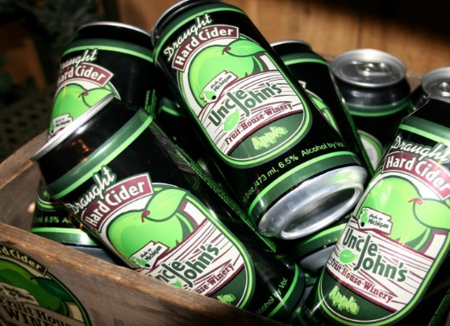
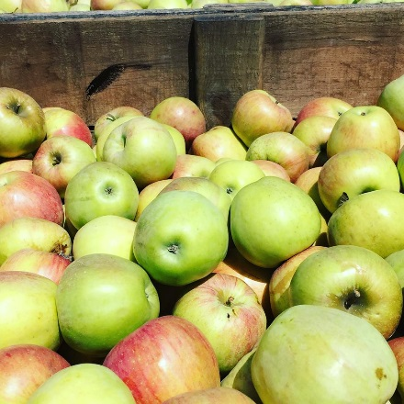
Change in Physical State
An irreversible processing activity that alters the raw agricultural commodity and enhances its value and is something other than a post-harvest process that primarily acts to preserve the commodity for later sale.
Examples include, but are not limited to-
milk into cheese
wheat into flour
wool into clothing or rugs
corn into E-85 ethanol
livestock into packaged meat
Uncle John’s Hard Cider

Slide 21


Produced in a manner that enhances the value of the agricultural commodity
The value-added product results from the use of a recognizably coherent set of agricultural production practices in the growing of the raw agricultural commodity, such that a differentiated market identity is created for the resulting product.
Nonstandard production method that adds value per unit of production over a standard production method, and demonstrates this by a quantifiable comparison with products produced in the standard manner.
Examples include, but are not limited to-
organic carrots,
eggs produced from free-range chickens.

Slide 22
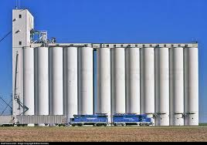
Physical Segregation
Value-added product results from physically separating (i.e. distance or structure) the agricultural commodity from other varieties of the same commodity on the same farm during production and harvesting, with continued separation during the processing and marketing of the value-added product.
Example: GMO corn separated from non-GMO corn on the farm during production and harvesting, with continued separation through marketing.

Slide 23
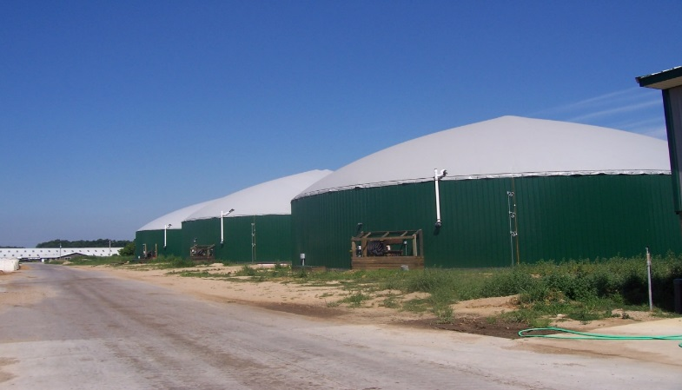
Farm- or Ranch-Based Renewable Energy
An agricultural commodity that is used to generate renewable energy on a farm or ranch owned or leased by the independent producer applicant that produces the agricultural commodity.
Examples include, but are not limited to-
dairy manure into methane and
electricity generated on the farm
corn into biodiesel generated on the
farm.
Generation of energy from wind, solar,
geothermal or hydro sources are not eligible.
Scenic View Dairy Digester
Notes:
Actual language is “is a source of Farm- or Ranch-based Renewable Energy.”

Slide 24

Locally-Produced Agricultural
Food Product
Any agricultural food product that is marketed and distributed within 400 miles of the product’s origin or within the State in which the product is produced.
Examples include, but are not limited to-
specific local grapes with characteristics attributable to the growing area sold to a winery that will produce a local wine;
local sweet corn advertised and sold at a premium as a fresher locally-produced alternative to non-local produce.
Notes:
Food for human consumption only.

Slide 25

All applicants must demonstrate Increase of Customer Base:
Include baseline of current customers for the commodity or value-added product
Increase in customer base – include estimated number of customers that will result from project

Slide 26

All applicants must demonstrate a greater portion of revenue returned to producers
Include a baseline of current revenues from the sale of the agricultural commodity or value-added product, AND
Include an estimated target of increased revenues that will result from the project

Slide 27
Examples of Eligible Uses of Funds
Planning Grants
Pay for a Qualified Consultant to conduct and develop a Feasibility Study, Business Plan, and/or Marketing Plan associated with the processing and/or marketing of a Value-added Agricultural Product
Notes:
Failure to become familiar with 4284.925 and .926 are one of the biggest applicant downfalls. These sections of the program regulations contain examples (not all-inclusive) of eligible and ineligible costs.

Slide 28
Variations on Working Capital Grants
Requests of $50,000 or more
(emerging market proposals)
All applicant types; but required for cooperatives, agricultural producer groups, and majority-controlled.
Must provide a third-party, project-specific feasibility study and a business plan related to the processing and/or marketing of the value-added product.
Notes:
Emerging market is required for all applicant types EXCEPT Independent Producers. However, Ips proposing emerging market projects must also submit a feasibility study and business plan.

Slide 29
Variations on Working Capital Grants
2. Requests of $50,000 or more
(market expansion)
Independent Producer (IP) applicants only;
Proposing market expansion of an existing value-added product that they have produced and successfully marketed for at least two years at time of application; and
In lieu of an independent feasibility study for this project, must submit a business or marketing plan for the value-added project .
Notes:
Recall that IP’s are not subject to ‘emerging market’ requirement.
This does not change the proposal evaluation or scoring elements and must demonstrate the expected increases in customer base and revenue returns to the producer applicants supplying the majority of the agricultural commodity for the project.

Slide 30
Variations on Working Capital Grants
3. Applications requesting less than $50,000 (Simplified)
All applicant types;
Not required to provide a feasibility study and business plan, but must demonstrate the expected increases in customer base and revenue returns to the producer applicants supplying the majority of the agricultural commodity for the project.
Notes:
This does not change the proposal evaluation or scoring elements and must demonstrate the expected increases in customer base and revenue returns to the producer applicants supplying the majority of the agricultural commodity for the project in

Slide 31
VAPG
Examples of Eligible Uses of Funds
Working Capital
Pay costs of processing the raw commodity into the value-added product.
Product packaging & labeling
Ingredients
Promotional materials
Advertising

Slide 32
Examples of Ineligible Uses of Funds
Most common issues
Expenses related to agricultural production/harvesting
Planning, building, or repairing facilities
Conflict of Interest or the Appearance of Conflict of Interest
Use of grant funds to pay self or associated parties for subject raw commodity
Entertainment expenses
Equipment expenses
Notes:
Program regulation at 4284.927 contains a list of 20 examples of ineligible uses!

Slide 33
Work Plan & Budget
Provide a detailed work plan and budget that shows:
how the project’s goals will be accomplished including a narrative description of the eligible activities and associated tasks;
a budget breakdown of estimated costs allocated to those activities and tasks;
identification of the key personnel responsible for overseeing and/or conducting the activities or tasks
Timeframes for completion of activities and tasks;
Identification of sources and uses of grant and matching funds for all activities and tasks;
Grant period that meets start and end date requirements.
Notes:
Work Plan & Budget is both an eligibility requirement AND a scoring criterion.

Slide 34
Task Budget Format
You must provide a budget table for each task that will be completed for each main activity and a detailed explanation/clarification for each task budget, including the basis for valuation for each budget line item.

Slide 35
Work Plan & Budget
If Program Income is earned during the grant period as a result of the project activities, it must be managed and reported accordingly.
See 2 CFR 200.306.
Program Income means gross income earned by the grantee that is directly generated by a supported activity or earned as a result of the grant, including, but not limited to income from the sale of commodities or products produced under the grant.
Notes:
Depending on the project, Program Income may not be a big deal. A working capital grant for a start-up venture and/or an emerging market might not generate much income in the near term (within the grant period).
On the other hand, a market expansion grant has the potential to generate income during the grant period, in excess of total project costs.
A way to minimize the impact of program income is by deducting “costs incidental to the generation of program income from gross income to determine net program income, provided these costs have not been charged to the Federal award”.
Is there is program income, Grantees must use it in one or a combination of the following ways:
1. Additive method
2. Cost sharing/match method
3. Deductive method

Slide 36
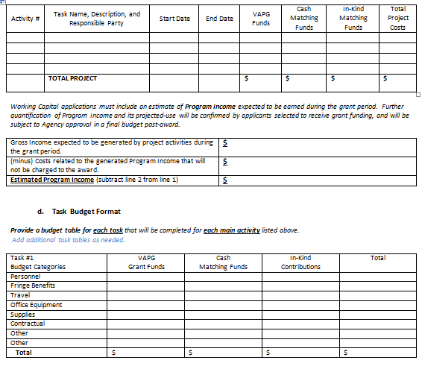
Summary Budget Templates
Program Income estimate (WC only)
Individual Task Budget Templates

Slide 37

Performance Evaluation Criteria
Applicant suggests one or more relevant criterion to be used to evaluate whether or not the primary goals and objectives of the project are being met
All applicants estimate how many jobs are expected to be created or saved as a result of the project
Working capital applicants record data on expansion of customer base and increase in revenue from the Applicant eligibility section

Slide 38
Proposal Evaluation Criteria
The Agency selects and ranks applications based on responses to 5 criteria:
Nature of the proposed project (0-30)
Qualifications of project personnel (0-20)
Commitments and support (0-10)
Work plan and budget (0-20)
Priority points (0 or 5/up to 5 additional)

Slide 39

Matching Funds must be…
Equal to at least the grant amount (at least 50 percent of total project costs) recommend matching funds be exactly 50 percent of project – not more
Spent only on eligible expenses
Spent in advance of grant funding (for every dollar of grant funds disbursed, not less than an equal amount of matching funds will have been expended prior to submitting the request for reimbursement)
From eligible sources without a real or apparent conflict of interest

Slide 40
Matching Funds
must be in the form of…
Applicant cash, loan, or line of credit
Applicant or family member in-kind contributions of goods or services (applicant provided services limited to 25 percent of total project costs)
Third-party cash
Third-party in-kind contribution, including non-federal grant sources

Slide 41

Completeness Eligibility
Applications must contain ALL required elements to be eligible to compete for funds
Information submitted after the application deadline cannot be accepted
Tips:
  Refer back to the checklist at the front of the template
  Answer each question in the template
  Turn into USDA a month early for review and suggestions

Slide 42
Where to send applications:
USDA Rural Development
Attn: Bobbie Morrison
3001 Coolidge Road, Suite 200
East Lansing, MI 48823
Bobbie Morrison:
bobbie.morrison@mi.usda.gov (517) 324-5222
Lisa Epple
lisa.epple@mi.usda.gov (269)463-8030
Natalie Garr
natalie.garr@mi.usda.gov (517) 324-5223
Traci Smith
traci.smith@mi.usda.gov (517) 324-5221
Who to contact for assistance:

